Slide 1
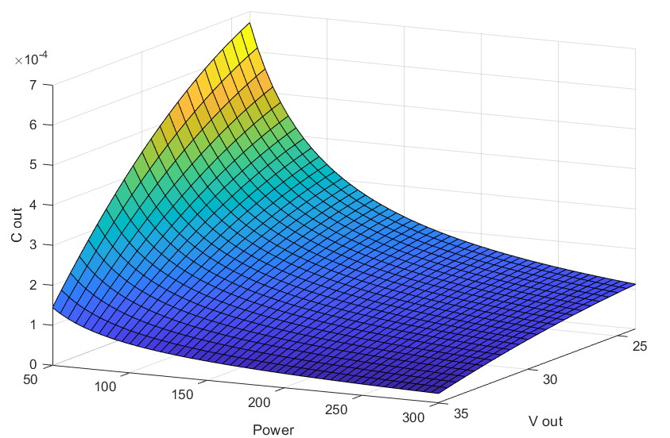
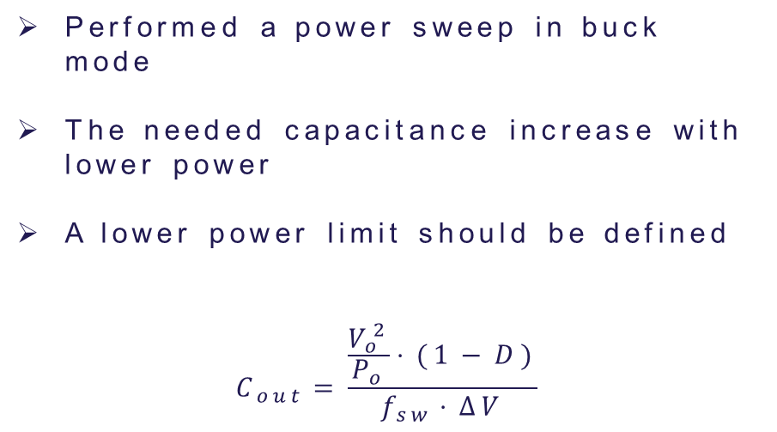
Output capacitor sizing
Performed a power sweep in buck mode
The needed capacitance increase with lower power
A lower power limit should be defined
$$C_{out}=\frac{\frac{V_{o}^{2}}{P_{o}}⋅(1−D)}{f_{sw}⋅ΔV}$$

Slide 2
Switching frequency
Switching frequency increase:
Switching losses increase
Component size decrease
Higher losses, lower cost
Switching frequency decrease:
Switching losses decrease
Component size increase
Lower losses, higher cost
RT-box would have to support the chosen frequency

Slide 3
Time Management Table
Name | Time holding breath under water | Time without criticizing work | Time used for eating
Nicolai | 29:10 | 29:10 | 20:00
Thassilo | 10:02 | 10:02 | 20:00
Aitor | 00:17 | 00:17 | 20:00
Nicolas | 19:57 | 00:00 | ∞

Slide 4
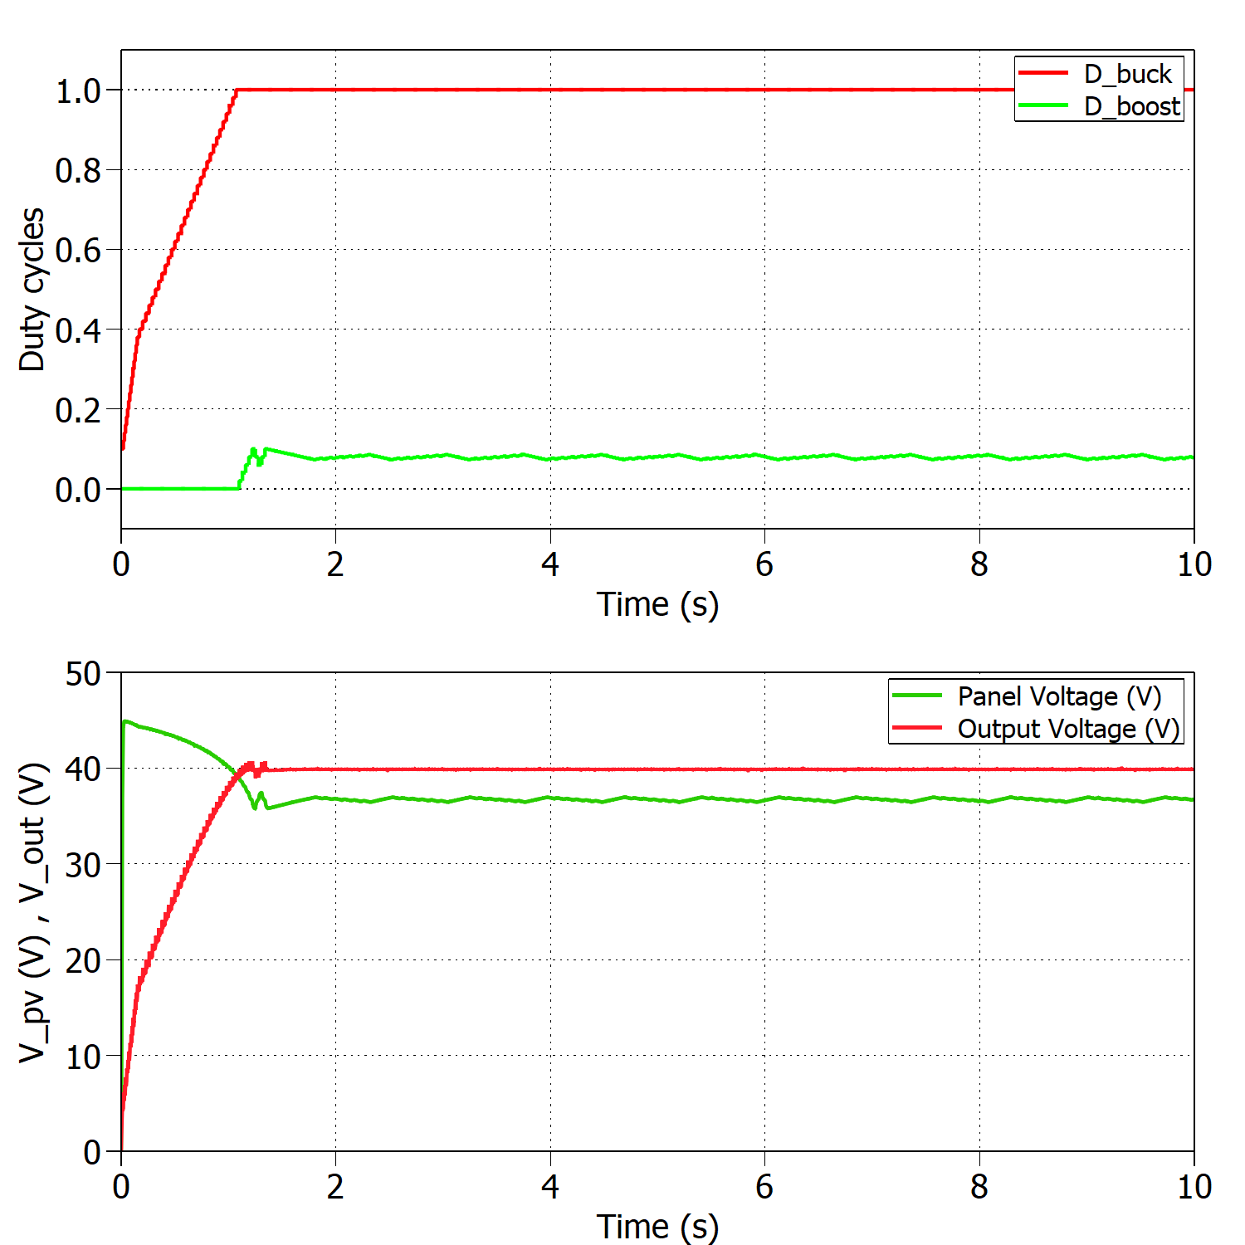
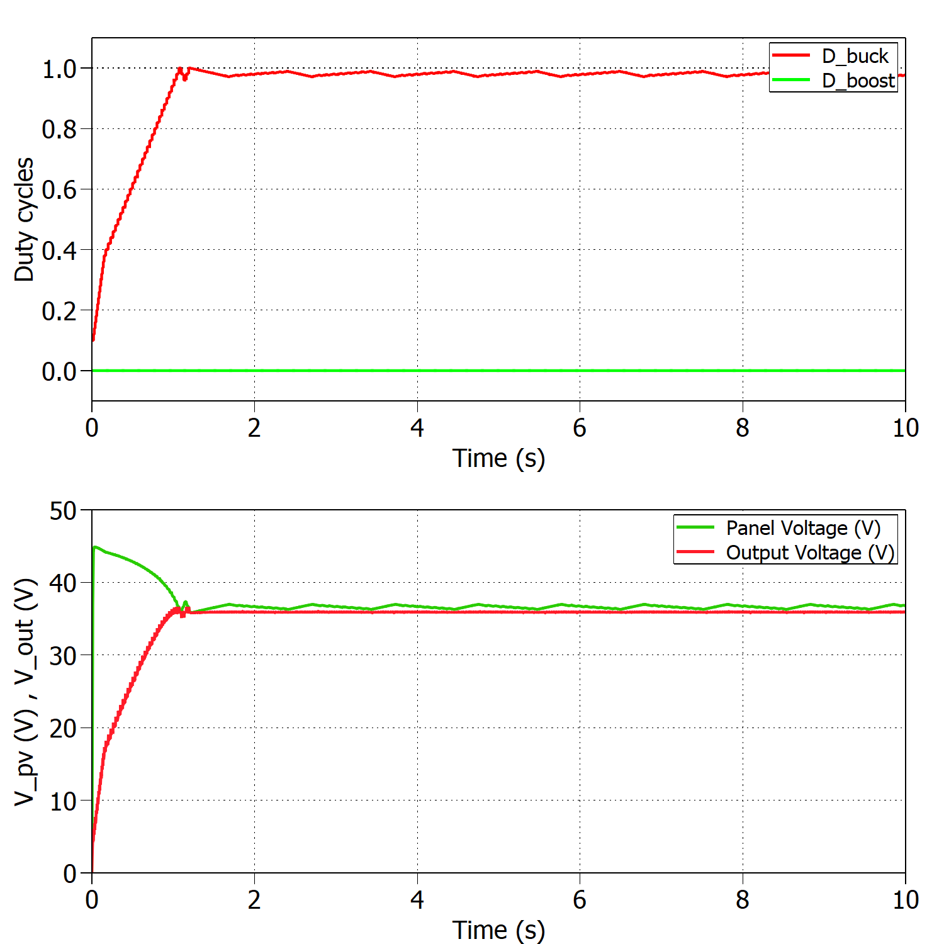
Time Management Table
Add a nice looking caption if you have multiple figures at one slide
And make sure that they are better aligned than this…

